Slide 1
Breaking the 2 Pizza Paradox with your Platform as a Application Mark Rendell mark.rendell@accenture.com @markosrendell http://markosrendell.wordpress.com
Notes:
The benefits treating your Platform as an Application

Slide 2
Day Job
A globally networked pool of resources providing projects the option to have key areas of their DevOps delivered as a service. By emphasising Continuous Delivery, we are able to vastly improve your Software Delivery Lifecycle at all each stages including Transformation, Mobilisation and Assessment
We can…
Take a project from a standing-start to a working Development and Tools infrastructure in days
Increase Agility by using our pioneering methods for Continuous Delivery
Increase productivity and predictability through fully automated environments
4. Reduce Cost by using proven processes and expertise to reduce errors and downtime
DCSC
Increase quality and efficiency
PaaS
Cloud
Continuous Delivery
Build & Deploy Automation
Infrastructure as code
Tools
Software Configuration Management
Release Management
Environment Management
Notes:
Work for Accenture and have the absolute pleasure of
running a team of around 180 people who are all heavily into DevOps P
We work on 10s engagements,
Which means 100s of environments,
and thousands of git repos
and maybe 10s of thousands of Jenkins jobs and monitoring checks P
More about my team later when I talk about putting my theories into practice

Slide 3
The Objective
Notes:
I’m gonna start with what I think we are trying to achieve with DevOps

Slide 4


Value Stream
Idea
Value
Notes:
The simplest way I can think about our objective is as follows:
Someone has an idea.
They need to get it implemented and in front of customers so that as soon a possible
If the idea is good the business will start generating more value P
If not, well at least we learnt quickly
If that change involves an IT system, we’re interested in helping make this as easy as possible P

Slide 5
DevOps definition (of the moment):
We value:
Enhancing IT systems
to meet the Business’ needs over
IT operating efficiency
Notes:
I think it’s an earned indulgence that if you are presenting on DevOps, you get to add a definition to the mix.
Right now, I’m going for this:
<click>
We value enhancing IT System to meet the business’ needs
over
IT operating efficiency P
So it’s all about throughput of change. P
I’m not saying we aren’t conscious of costs, of course we are
But we need to be very up front that DevOps is not about replacing the IT folk with automation and building a factory of robots,

Slide 6
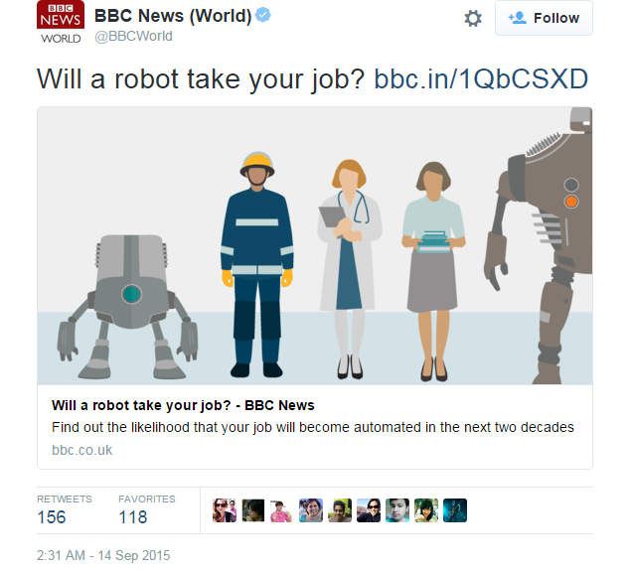
Value Stream
Idea
Value
Notes:
It does seem to have been a bit of a popular idea lately that the robots are coming for our jobs…
No. DevOps, is about making IT within an organisation, and hence the business better.

Slide 7
The Problem
Notes:
So why might improving throughput be so hard? P

Slide 8



Development
Team
Operations
Team
Portal
Portal
CMS
IB
CMS
IB
ERP
PIM
ERP
PIM
CRM
CRM
Platform
Notes:
We all know how to draw a diagram of DevOps
Draw two circles and you are halfway there P
You’ll note I’ve drawn on a few typical enterprise systems – a Portal, an ERP system, a CRM systems, standard stuff.
Both teams interact with these systems in different ways…
And neither team interacts well with each other P
So is this what DevOps looks like in an enterprise? P
Well actually… No… Absolutely not!
I have never seen anything this simple
This looks lovely

Slide 9

Project Rel. 3 Team
UI Design Team
Portal
Networks Team
Portal
CMS
IB
Portal
CMS
CMS
IB
Project Rel 1 Team
ERP
PIM
Enterprise Systems Dev Team
Portal
CRM
ERP
CMS
Portal
PIM
CRM
IB
Platform
CMS
IB
Platform
Enterprise Architects
Portal
CMS
IB
Server and Storage Team
ERP
PIM
CRM
ERP
PIM
CRM
Portal
CMS
IB
Platform
Platform
ERP
PIM
CRM
DBA Team
SysAdmin Team
ERP
Platform
CMS
Portal
Portal
PIM
CRM
Project Rel. 2 Team
IB
CMS
Portal
IB
Platform
CMS
IB
ERP
PIM
CRM
Platform
ERP
PIM
CRM
Legacy System App Maint, Team
Platform
Legacy System Operations Team
Portal
Portal
ERP
PIM
CRM
Platform
ERP
PIM
ERP
PIM
CRM
CRM
Platform
Platform
Notes:
This is a far more typical example
A nightmare of lots of teams, everywhere!
This was from somewhere I worked several years back.
I drew this slide a week ago and I still keep on remembering more teams. P
Far from a one development team, there were at least 5 teams, some working on the same code just targeting different releases P
And far from one IT Ops team,
there was a Server team, the DBAs,
the SysAdmins (actually one team for Windows, one for Linux – don’t put those guys together… P
I believe this is far closer to the organisation structure that most enterprises have to consider when looking at to increase throughput P

Slide 10
DevOps?
Portal
CMS
IB
ERP
PIM
CRM
Platform
Notes:
So why don’t we just do this…
Try building a massive team? P
Obviously this is just unrealistic
Inevitably a team of this scale would be unmanageable,
it will subdivide
and organisational muscle memory would restore things to exactly how they were P

Slide 11

Big pizzas are good
Big teams are bad
Notes:
Beside which, not only giant teams, but large teams are it generally considered quite bad.
For example Jeff Bezos from Amazon is reported to recommend teams that can all be fed with two pizzas. P
When I quote this, it always provokes a great discussion about how many people that actually means.
There’s always at least one person who claims they could eat 2 pizzas to them self.
But anyway, it’s designed to mean that teams should not be bigger than 6-8 people. P
How in a big enterprise, do you create end-to-end teams to deliver high throughput complex IT
without the side effect of large teams?
This is what I call: “The Two Pizza Paradox.” P

Slide 12


Problem Space
Idea
Idea
Plan
Develop
Package
Deploy
Test
Release
Operate
Content Management System
Portal
ERP System
CRM System
Value
Notes:
Einstein is reported to have said:
“If I had an hour to solve a problem I'd spend 55 minutes thinking about the problem and 5 minutes thinking about solutions.”
Well I’m not claiming to be Einstein and we don’t have an hour.
So let’s spend a couple of minutes visualising the problem space P
<click>
This is a simple abstraction of the end to end software lifecycle
And our problem is getting working solutions through this end-to-end P
<click>
And let’s not forget that we have a lot of systems that may be impacted by the change
This list is definitely too short for most enterprises and I’d expect far more systems

Slide 13
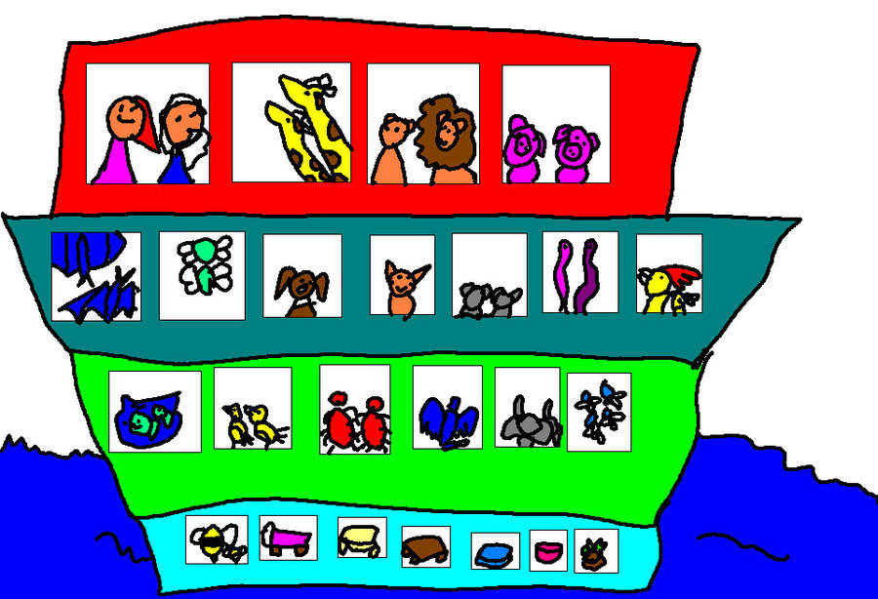
Rainforests not Zoos
http://img04.deviantart.net/51c8/i/2009/202/3/7/noah__s_ark_2_by_dinzydragon.jpg
Notes:
Now traditionally what do we do with our people? P
Especially in operations, we group them by skillset.
Let’s put the database experts in a DBA team
Let’s group the systems administrators (don’t mix Windows and Linux)
Let’s put the Java developers over there
The testers over there
It’s really a lot more like we’re organising a zoo. P
And with a zoo you certainly aren’t thinking about getting the animals to collaborate towards a common goal P
No when you organise a zoo, you are trying to stop animals eating each other, Or worse eating people! P
The zoo metaphor goes even further for me because ironically zoos necessarily a great environment for nature to thrive in
If you think about a rainforest there is an amazing thriving autonomous ecosystem
filled with incredible symbiotic relationships P
Zoos take a lot of money and micro management just to keep running.

Slide 14
Idea
Plan
Develop
Package
Deploy
Test
Release
Operate
UI Design Team
Project Rel 1 Team
Networks Team
Enterprise Architects
SysAdmin Team
Enterprise Systems Dev Team
Project Rel. 2 Team
Server and Storage Team
Project Rel. 3 Team
DBA Team
Legacy System App Maint, Team
Legacy System Operations Team
Notes:
Let’s think back to traditional teams P
They are literally scattered over the process we are trying to optimise
I haven’t even tried to draw lines of communication on here
Conway would have a field day

Slide 15
The Solution
Notes:
So what can we do?

Slide 16
Idea
Plan
Develop
Package
Deploy
Test
Release
Operate
UI Design Team
Content Management System
Portal
ERP System
CRM System
Project Rel 1 Team
Networks Team
Enterprise Architects
SysAdmin Team
Enterprise Systems Dev Team
Project Rel. 2 Team
Server and Storage Team
Project Rel. 3 Team
DBA Team
Legacy System App Maint, Team
Legacy System Operations Team
Notes:
Well I think we have to rethink our lines of division
And we have to go back to prioritising our products.
<click>
These are the things we need to optimise for
There are what we need to protect end to end.

Slide 17
Idea
Plan
Develop
Package
Deploy
Test
Release
Operate
UI Design Team
Content Management System
Portal
ERP System
CRM System
Project Rel 1 Team
Networks Team
Enterprise Architects
Development and Operations Team
SysAdmin Team
Enterprise Systems Dev Team
Development and Operations Team
Project Rel. 2 Team
Server and Storage Team
Project Rel. 3 Team
Development and Operations Team
DBA Team
Legacy System App Maint, Team
Development and Operations Team
Legacy System Operations Team
Notes:
So let’s create end to end teams to develop and operate products. P
Each product now just has one owning team primality concerned with it’s welfare and hence our ability to evolve it as fast as the business needs,

Slide 18
Idea
Plan
Develop
Package
Deploy
Test
Release
Operate
UI Design Team
Content Management System
Portal
ERP System
CRM System
Project Rel 1 Team
Networks Team
Enterprise Architects
Development and Operations Team
Services
SysAdmin Team
Enterprise Systems Dev Team
Development and Operations Team
Development and Operations Team
Project Rel. 2 Team
Server and Storage Team
Development and Operations Team
Development and Operations Team
Project Rel. 3 Team
Development and Operations Team
DBA Team
Legacy System App Maint, Team
Development and Operations Team
Legacy System Operations Team
Notes:
Now to keep team sizes down, we may well need to decompose products
And the logical conclusion here is implementing a microservices architecture…
Valuable and trendy!
I feel another DevOps definition coming on…

Slide 19
DevOps definition (of the moment):
Organising for throughput by
forming teams that both
Develop and Operate
Products end-to-end
Notes:
DevOps means Organising for throughput by
forming teams that both
Develop and Operate
Products end-to-end
So I think re-interpreting the name puts us on a pretty good path.

Slide 20
Idea
Plan
Develop
Package
Deploy
Test
Release
Operate
UI Design Team
Content Management System
Portal
ERP System
CRM System
Networks Team
Project Rel 1 Team
Networks Team
Enterprise Architects
Development and Operations Team
SysAdmin Team
SysAdmin Team
Services
SysAdmin Team
Enterprise Systems Dev Team
Development and Operations Team
Project Rel. 2 Team
Server and Storage Team
Server and Storage Team
Development and Operations Team
Development and Operations Team
Project Rel. 3 Team
Development and Operations Team
DBA Team
DBA Team
Legacy System App Maint, Team
Development and Operations Team
Legacy System Operations Team
Legacy System Operations Team
Notes:
So this approach has a lot of promise for applications
But what about these guys …
<click>
The problem with this approach is that it doesn’t necessarily improve the quality of our platform
and these typical very technical, traditionally operations concerns P
We could consider trying to embed them also into the end to end application teams
But in reality that is going to cause those teams to get too big.
And it is also likely to lead to duplication and potentially un-necessary complexity and fragmentation. P

Slide 21
Idea
Plan
Develop
Package
Deploy
Test
Release
Operate
UI Design Team
Content Management System
Portal
ERP System
CRM System
Project Rel 1 Team
Networks Team
Enterprise Architects
Development and Operations Team
Services
SysAdmin Team
Enterprise Systems Dev Team
Development and Operations Team
Project Rel. 2 Team
Server and Storage Team
Development and Operations Team
Development and Operations Team
Project Rel. 3 Team
Development and Operations Team
DBA Team
Legacy System App Maint, Team
Development and Operations Team
Legacy System Operations Team
Platform
Application
Development and Operations Team
Notes:
So let’s recognise that the platform is also a first class product P
It will also benefit from an end to end team
And potentially we now have a new approach and a new mind-set for something that has traditionally been
very hard to define and had ownership shared by lots of teams,
And we have a way to tackle something I think is almost always the greatest constraint to throughput

Slide 22
Platform as an Application
Hardware management
Basic Infrastructure orchestration
Platform Infrastructure orchestration
Third Party Installations
Deployment architecture
Security model
Logical environment separation
Business
Applications
Platform
Application
(Could use Infrastructure as a Service)
Notes:
So let’s define a platform application
Essentially it is the thing on which everything else is run <click>
Everything else could be called your business applications
I think so platform-centrically, I think of them as guest applications
So what does a platform need to do, to provide this service?
Well it’s all an exercise of abstracting away un-necessary detail
Or if you like encapsulating complexity.
<click> Firstly it needs to be the only thing aware of hardware
and we need to ensure that we have full programmatic access to control that.
Now both of these are taken care of for you if you use Infrastructure as a service (or IaaS) – which I highly recommend
<click> Next we need to recognise the need to support high-availability, auto recovery and auto-scaling. Essentially we need the platform to have inbuilt logic for handling failure and a dynamic workload.
<click>We need to handle installation and configuration of all software that sits on top of the operating system, but below the business applications, so this could be a MySQL installation, or RabbitMQ etc.
<click>Next we need a strategy for producing different test environments. A good platform application will have a well defined approach for easily creating, re-creating and deleting environments – and needs to be self service
<click>A great platform application will also take care of supporting easy deployments of the business applications onto it – it needs to be very easy to use.
<click>Finally like all applications, security and in particular role based access control is an essential concern. For an application as powerful as this we need to be able to control it’s use. P
So if we use a model like this, we can start to recognise the logical product that we have to work on.

Slide 23
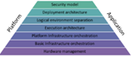
Idea
Plan
Develop
Package
Deploy
Test
Release
Operate
Content Management System
Portal
ERP System
CRM System
Platform
Development and Operations Team
Development and Operations Team
Development and Operations Team
Development and Operations Team
Development and Operations Team
Development and Operations Team
Notes:
The great thing about defining your platform as an application is that it suddenly has a lot more in common with the other applications
<click>
All components need to be developed and supported and owned end to end
All teams are essentially doing the same process:
Controlling scope, developing code, testing it,
managing dependencies with other applications
releasing it,
ideally doing Continuous Delivery

Slide 24
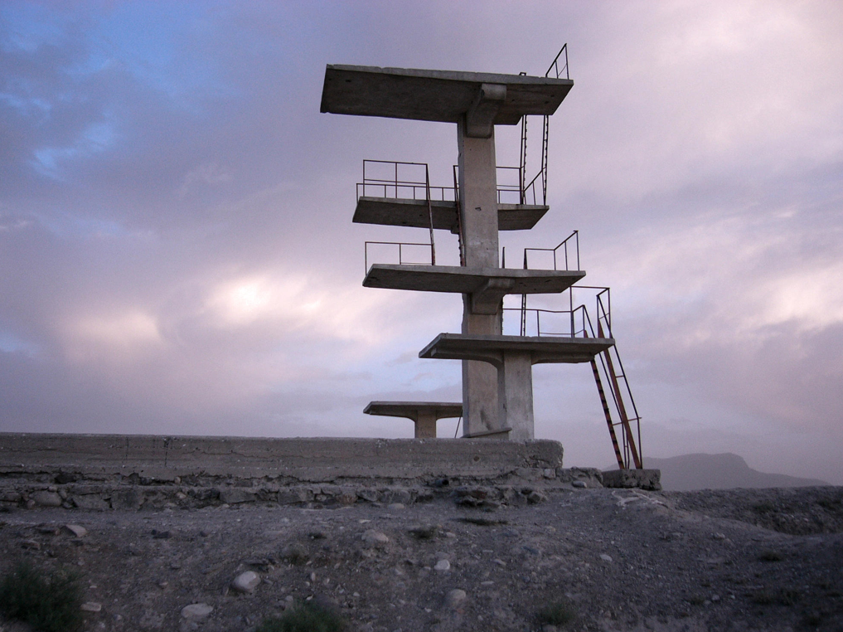
Public PaaS?
https://upload.wikimedia.org/wikipedia/commons/c/cb/Kabul_diving_platform.jpg
Notes:
So could you just use a public PaaS?
If you can find one the with features and terms and conditions that suit your needs then it’s a real option.
Personally I haven’t seen that many enterprises doing this
SaaS yes, IaaS increasingly, PaaS no.
Overall I think really the most important question should be:
– is your platform part of your business differentiation?
If so you are going to have to build it.
As a believer in platforms, I think generally it is worth self-managing

Slide 25

Build or Buy?
We say yes
Build or Buy?
https://www.flickr.com/photos/nicorien/118131870
https://farm2.staticflickr.com/1370/898160943_35ef6551c7_o_d.jpg
Notes:
Just like business applications for example a CRM system, with a platform you also have the option to build or buy off the shelf
P
Having spent many years battling COTS products and trying to do build and deployment automation with them… I have a learnt preference to build
P
Having said that, we built a platform for a UK public service and used community cloud foundry and it worked out very well

Slide 26






Engineered
https://github.com/bbatsov/rubocop
Platform data centre
Dev/Test data centre
Prod data centre
Committer: jdoe Story:25
Sonar Code Analysis
Package
Create Platform
Test Platform
Create Platform
Test Platform
Create Platform
Test Platform
Commit ID: 113
Run Unit Tests
http://rspec.info/
Notes:
So to explore the idea a little further I’m going to go through a number of things you do with a good platform application
The first is that you need to engineer it like any other application.
This means building one or more Continuous Delivery pipelines
The normal rules apply
Start with everything in version control,
have some static code analysis
Have some run time tests
Deploy and run an instance
And run your tests continuously
For the case of the platform the good thing is that there is already standard practice for this – called monitoring!

Slide 27
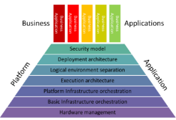
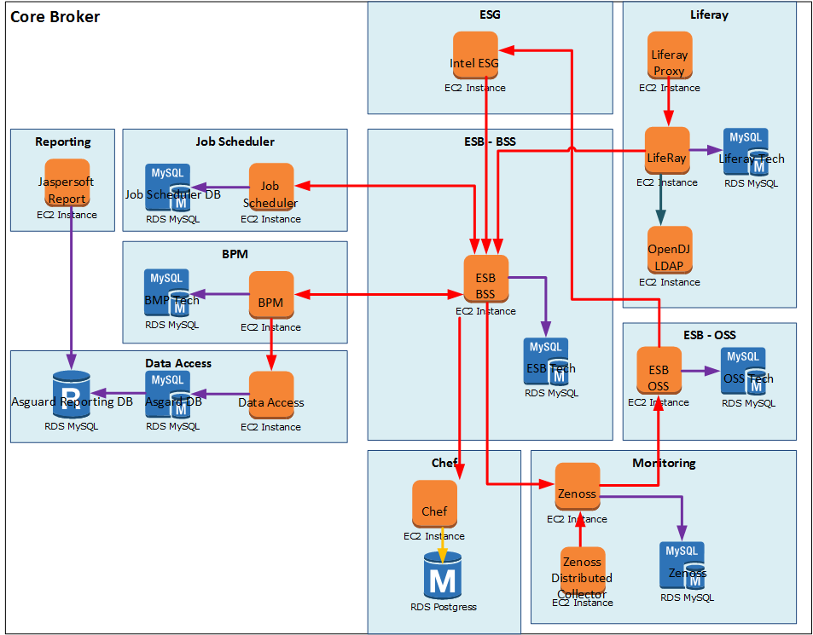
Re-creatable
319
Platform and basic infra automation >
319
319
319
319
319
Virtual Private Cloud
Networks
319
Virtual Machines
319
319
Notes:
You must be able to recreate the platform from scratch
I think it was Martin Fowler who first compared rebuilding a data centre from scratch as being like a phoenix bird rising from the ashes
In my team we like to treat phoenix as a verb.
“When did we last phoenix the platform instance.?”
And this really should mean everything
The network and base servers

Slide 28












Re-creatable
319
Third Party Software >
319
319
319
319
319
Virtual Private Cloud
Networks
319
Virtual Machines
Software Installs
319
319
Notes:
The Third Party Installations and configuration

Slide 29

Re-creatable
319
319
Tools in the Cloud (Monsoon)
Deployment architecture >
Reporting
Scheduler
319
BPM
ESG
319
DAL
319
319
Proxy
BSS ESB
319
Portal
Chef
Virtual Private Cloud
LDAP
Networks
319
OSS BSS
Virtual Machines
Monitoring
Software Installs
Jenkins Deploy
319
319
Notes:
And all of the application code, configuration and base data deployment

Slide 30
Platform Interface (Opinions)
Interface
Hardware management
Basic Infrastructure orchestration
Platform Infrastructure orchestration
Third Party Installations
Deployment architecture
Security model
Logical environment separation
Business Applications
Opinions
Business
Applications
Platform
Application
Notes:
All applications need a interface to let other applications know how to work with them and the platform is no different.
These are often called platform opinions P
In the case of platform applications, the interfaces tells business applications what they need to do so that they can be hosted. P
Typical opinions might be views on how and where to log
What package format you need to produce so that you application can be deployed
How you application consumes configuration values
The 12 Factor App is a great example of this
Very clearly written and very easy to find P
When you have strong platform opinions, I think the old adage “good boundaries make good neighbours” fits very nicely. P

Slide 31
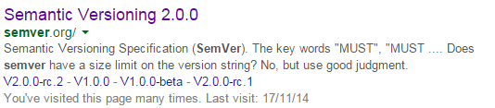
Release Manageable
Platform data centre
Dev/Test data centre
Prod data centre
Committer: jdoe Story:25
Sonar Code Analysis
Package
Create Platform
Test Platform
Create Platform
Test Platform
Create Platform
Test Platform
Commit ID: 113
Run Unit Tests
Notes:
If we’ve defined an interface or set of opinions for out platform we have to recognise that change is inevitable.
So we need a clear approach to releasing new versions of our platform application. P
Semantic versioning is a release version naming standard
where the numbers reflect the compatibility of the release relative to earlier releases.
I think it can nicely be applied to platforms as well.
There are three levels of change and very simple interpretation would be:
A minor means minimal testing,
a medium release means testing is required
and a major release means application re-work is probably required. P
It’s great to have a very clear, standardised, visible way of demonstrating that something in the underlying infrastructure has changed.

Slide 32
Integration Tested
Whole Solution
Version: 46
Website
Version: 12
Order Service
Version: 1.0.2.12
Email Service
Version: 1.0.0.3
Payment Service
Version: 1.2.0.23
Deployment tools
Version: 1.2.3.2
Platform
Version: 83
Cloud Foundry
Version: 23
MySQL
Version: 12
Cassandra
Version: 24
RabbitMQ
Version: 12
Infrastructure
Version: 19
Notes:
And once we recognise that our platform application changes, we need to support testing the integration of the upgraded platform with other systems.
This is the component breakdown structure from a recent project I was working on
The platform components are over on the right.
In this case our platform application was an extended version of cloud foundry.

Slide 33

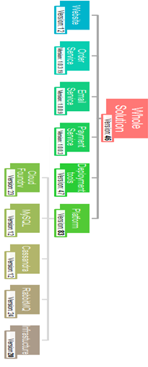

Integration Tested
Non prod data centre: v1.3.9
Prod data centre: v1.3.9
Check
in
Compile
and package
Static Code Analysis
Unit Tests
CT env
deploy
Run Functional Tests
Run Security Tests
PT env deploy
Run Tech Tests
Production deploy
Check
in
Compile
and package
Static Code Analysis
Unit Tests
CT env
deploy
Run Functional Tests
Run Security Tests
PT env deploy
Run Tech Tests
Production deploy
Check
in
Compile
and package
Static Code Analysis
Unit Tests
CT env
deploy
Run Functional Tests
Run Security Tests
PT env deploy
Run Tech Tests
Production deploy
Check
in
Compile
and package
Static Code Analysis
Unit Tests
CT env
deploy
Run Functional Tests
Run Security Tests
PT env deploy
Run Tech Tests
Production deploy
Platform data centre: v1.3.9
Platform
Check
in
Compile
and package
Unit Tests
Platform env deploy
Monitoring tests
Check
in
Compile
and package
Unit Tests
Platform env deploy
Monitoring tests
Check
in
Compile
and package
Unit Tests
Platform env deploy
Monitoring tests
Check
in
Compile
and package
Unit Tests
Platform env deploy
Monitoring tests
Check
in
Compile
and package
Unit Tests
Platform env deploy
Monitoring tests
Notes:
We started by building our own “platform development” instance of the platform.
We built pipelines for those components and when we were confident, we created an instance for people to test their applications in
Once they were happy we could build an instance for production and they could start releasing code

Slide 34
Integration Tested
Non prod data centre: v1.3.9
Prod data centre: v1.3.9
Check
in
Compile
and package
Static Code Analysis
Unit Tests
CT env
deploy
Run Functional Tests
Run Security Tests
PT env deploy
Run Tech Tests
Production deploy
Check
in
Compile
and package
Static Code Analysis
Unit Tests
CT env
deploy
Run Functional Tests
Run Security Tests
PT env deploy
Run Tech Tests
Production deploy
Check
in
Compile
and package
Static Code Analysis
Unit Tests
CT env
deploy
Run Functional Tests
Run Security Tests
PT env deploy
Run Tech Tests
Production deploy
Check
in
Compile
and package
Static Code Analysis
Unit Tests
CT env
deploy
Run Functional Tests
Run Security Tests
PT env deploy
Run Tech Tests
Production deploy
Platform data centre: v1.4.4
Platform
Check
in
Compile
and package
Unit Tests
Platform env deploy
Monitoring tests
Check
in
Compile
and package
Unit Tests
Platform env deploy
Monitoring tests
Check
in
Compile
and package
Unit Tests
Platform env deploy
Monitoring tests
Check
in
Compile
and package
Unit Tests
Platform env deploy
Monitoring tests
Check
in
Compile
and package
Unit Tests
Platform env deploy
Monitoring tests
Notes:
Whenever we needed to update our platform application, we needed to agree the upgrade of the non-production instance

Slide 35
Integration Tested
Non prod data centre: v1.4.4
Prod data centre: v1.3.9
Check
in
Compile
and package
Static Code Analysis
Unit Tests
CT env
deploy
Run Functional Tests
Run Security Tests
Check
in
Compile
and package
Static Code Analysis
Unit Tests
CT env
deploy
Run Functional Tests
Run Security Tests
Check
in
Compile
and package
Static Code Analysis
Unit Tests
CT env
deploy
Run Functional Tests
Run Security Tests
Check
in
Compile
and package
Static Code Analysis
Unit Tests
CT env
deploy
Run Functional Tests
Run Security Tests
Platform data centre: v1.4.4
Platform
Check
in
Compile
and package
Unit Tests
Platform env deploy
Monitoring tests
Check
in
Compile
and package
Unit Tests
Platform env deploy
Monitoring tests
Check
in
Compile
and package
Unit Tests
Platform env deploy
Monitoring tests
Check
in
Compile
and package
Unit Tests
Platform env deploy
Monitoring tests
Check
in
Compile
and package
Unit Tests
Platform env deploy
Monitoring tests
Notes:
And after we’d upgraded that, we couldn’t release to production until

Slide 36
Integration Tested
Non prod data centre: v1.4.4
Prod data centre: v1.3.9
Prod data centre: v1.4.4
Check
in
Compile
and package
Static Code Analysis
Unit Tests
CT env
deploy
Run Functional Tests
Run Security Tests
PT env deploy
Run Tech Tests
Production deploy
Check
in
Compile
and package
Static Code Analysis
Unit Tests
CT env
deploy
Run Functional Tests
Run Security Tests
PT env deploy
Run Tech Tests
Production deploy
Check
in
Compile
and package
Static Code Analysis
Unit Tests
CT env
deploy
Run Functional Tests
Run Security Tests
PT env deploy
Run Tech Tests
Production deploy
Check
in
Compile
and package
Static Code Analysis
Unit Tests
CT env
deploy
Run Functional Tests
Run Security Tests
PT env deploy
Run Tech Tests
Production deploy
Platform data centre: v1.4.4
Platform
Check
in
Compile
and package
Unit Tests
Platform env deploy
Monitoring tests
Check
in
Compile
and package
Unit Tests
Platform env deploy
Monitoring tests
Check
in
Compile
and package
Unit Tests
Platform env deploy
Monitoring tests
Check
in
Compile
and package
Unit Tests
Platform env deploy
Monitoring tests
Check
in
Compile
and package
Unit Tests
Platform env deploy
Monitoring tests
Notes:
Production was also upgraded

Slide 37
In practice
Notes:
So let’s talk about this in practice

Slide 38
Develop and Operate Platforms optimised for rapid delivery
A globally networked pool of resources providing projects the option to have key areas of their DevOps delivered as a service. By emphasising Continuous Delivery, we are able to vastly improve your Software Delivery Lifecycle at all each stages including Transformation, Mobilisation and Assessment
We can…
Take a project from a standing-start to a working Development and Tools infrastructure in days
Increase Agility by using our pioneering methods for Continuous Delivery
Increase productivity and predictability through fully automated environments
4. Reduce Cost by using proven processes and expertise to reduce errors and downtime
DCSC
\
Increase quality and efficiency
PaaS
Cloud
Continuous Delivery
Build & Deploy Automation
Infrastructure as code
Tools
Software Configuration Management
Release Management
Environment Management
@markosrendell
Notes:
I mentioned earlier that I run a team of people into DevOps, but I wasn’t much more specific than that.
What we actually consider ourselves to do is:
Operate like a very accommodating in house platform-as-a-service (or Paas) provider.
So we develop and operate tools and automated environments as a service
with a focus on maximising the agility and predictability of our customer’s delivery.
And is an approach that I think will work for others.
By accommodating, I mean that within reason, we will produce a platform to support whatever is requested
If someone needs a platform that supports Hybris, We say yes
Java? Yes
Adobe Experience Manager? Yes
Websphere Commerce Server? Ye-es
You get the picture …

Slide 39
Enterprise Scale is Heterogeneous
Retailer
Bank
Retailer
Energy Provider
Government
Service
Insurer
Retailer
Retailer
Trading Platform
Government
Service
Cloud
Broker
Energy
Provider
Notes:
So in my job, Enterprise scale looks a little bit like this.
I’ve got 10s of projects to support
Each wanting a platform where they can release rapidly
So a fairly heterogeneous landscape, but nothing wildly more complicated than I believe many enterprises have to contend with

Slide 40

Divide and deliver
Bank
Platform
Development and Operations Team
Notes:
So I need to keep things small and simple
We divide up the problem
Each project gets it’s own team and they have their own platform application to develop and operate
And of course they get their own pizzas
The team is responsible end-to-end for their platform application
And primarily concerned with the throughput that the platform supports
And hence their impact on the performance of the business they support

Slide 41
Divide and deliver
Retailer
Bank
Platform
Development and Operations Team
Retailer
Platform
Development and Operations Team
Platform
Development and Operations Team
Energy Provider
Platform
Development and Operations Team
Government
Service
Insurer
Platform
Development and Operations Team
Retailer
Platform
Development and Operations Team
Retailer
Platform
Development and Operations Team
Platform
Development and Operations Team
Trading Platform
Government
Service
Platform
Development and Operations Team
Energy
Provider
Cloud
Broker
Platform
Development and Operations Team
Platform
Development and Operations Team
Platform
Development and Operations Team
Notes:
So we just keep repeating that pattern

Slide 42
Divide and deliver
Retailer
Platform
Development and Operations Team
Trading Platform
Platform
Development and Operations Team
Notes:
And if we find we have a really big platform.
And people are going hungry (not enough pizza)
We divide things up again

Slide 43
Divide and deliver
Retailer
Platform
Development and Operations Team
Platform
Development and Operations Team
Platform
Development and Operations Team
Platform
Development and Operations Team
Trading Platform
Platform
Development and Operations Team
Platform
Development and Operations Team
Platform
Development and Operations Team
Notes:
We need to decompose the platform into smaller components
And build teams around those
Usually dividing according to groups of hosted business applications

Slide 44
Sharing over shared
Shared Tools Service
Platform
Development and Operations Team
Retailer
Bank
Retailer
Energy Provider
Government
Service
Insurer
Retailer
Retailer
Trading
Platform
Government
Service
Cloud
Broker
Energy
Provider
Notes:
We do have room for some shared services
So for example we have a tools platform that services multiple clients
- but not all.
Our emphasis is on promoting the act of sharing ideas, techniques and software i.e. tools and scripts
over trying to get everyone into a multi tenancy solution which might enforce choices or constraints they don’t need.

Slide 45
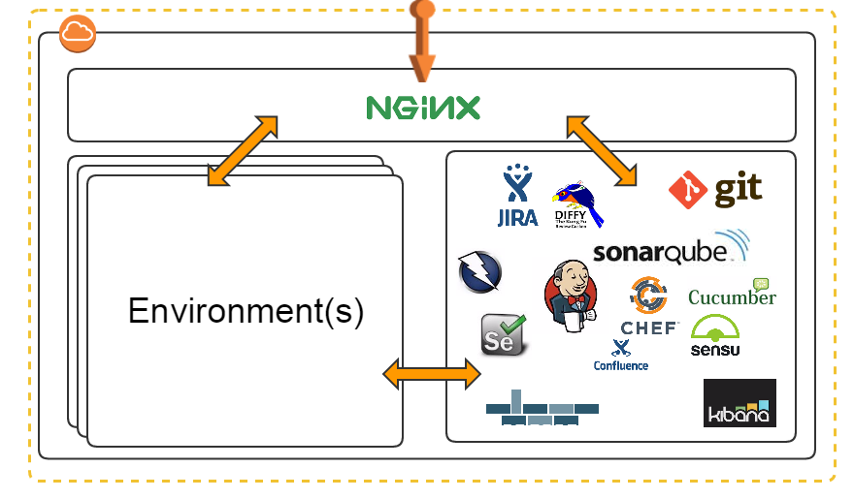
Starting over studying
Notes:
One of the biggest keys to establishing continuous delivery as a way of working
is lowering as far as possible the barrier to adopting tools and automation
If getting started is takes a lengthy tool assessment process, procurement, installation, configuration,
Engagements may run away and be forging manual habits before you know it.
We’ve tackled this by basically automating to the extreme spinning up tools and reference implementations.
In fact we’ve got it down to 10 minutes to go from nothing to all of these tools pre-configured and usable.
We call this our DevOps platform (partly because with a name like that – who could not want it)
And we’re hoping to open source it fairly soon.

Slide 46
Bootstraps over blueprints
Notes:
And when we need to get started for a particular technology for example:
Mule ESB, Or NodeJS, Or Hybris
We have a concept of bootstraps P
Far from being just designs or reference architectures, they are effectively plugins to the platform that enable us to add:
the means to create the environments,
example code,
and example continuous delivery jobs for a particular technology.
So when one exists, we re-use and extend it and if not, we build it.
It’s far easier for people to see and experience what good looks like rather than stare at a representation of it on a page.

Slide 47
Re-use over standards
Retailer
Bank
Retailer
Energy Provider
Government
Service
Insurer
Retailer
Retailer
Trading Platform
Government
Service
Cloud
Broker
Energy
Provider
Notes:
So it’s very key to us that we make everything as easy to re-use as possible.
However, no-one is forced to use anything for example Git and Jenkins,
I’ve found people are far more motivated if you empower them to make the right choices for themselves
And I think even more motivated if they know others are going to be interested in reusing their work.
So this has the effect that unofficial or rather unenforced standards do start to emerge.
And we continuously improve organically.

Slide 48
“Top 5 Takeaways”
Optimise for throughput not efficiency
Build end to end teams
Treat the platform as an application
Implement Continuous Delivery for your platform and via your platform
Lower the barrier to adoption
Notes:
So my key takeaways are as follows
(no pizza pun intended)
Optimise for throughput not efficiency – I do see people talking about efficiency through automation still and as a movement I think we need to defend against that logic
Build end to end teams – I really see no better re-interpretation of the word DevOps than saying that team should develop and operate things.
Treat the platform as an application – I think I’ve said enough about that
Implement Continuous Delivery for your platform and via your platform – i.e. eat your own dog food (and wash it down with your own champagne)
5. Lower the barrier to adoption – DevOps is hard, I’m a firm believer in starting small and avoiding doing things that just can be avoided

Slide 49
What I’m looking for help with
Collaboration on our forthcoming DevOps Platform open source project
More sharing of:
Platform opinions
How to subdivide big platforms into smaller components
Successes doing this
Notes:
And here is where I’d like your help and inputs
Firstly
It’s a little early for me to ask, but when you see our DevOps platform open source project launched, please take a look
Secondly if you are working with platform applications please share more with the community.
For example documenting your own platform opinions or version of the 12 factor app
Documenting how you’ve decomposed a big platform application into smaller concerns
And finally show off, if this is working for you don’t take it for granted, please spread the word.

Slide 50
Thank you!
Markos
Mark Rendell mark.rendell@accenture.com @markosrendell http://markosrendell.wordpress.com
Notes:
So this takes me to the end
I hope I’ve inspired you to think a little differently about platform applications
And some of you will be interested to try some of this at home
Thanks very much for listening!

